Slide 1






UNCOILING THE SERPENT:
AN INSIGHT INTO MODERN AGE INFOSTEALERS
Presentation by
Ananya Avvaru & Subhiksha Rao
October | 2024

Slide 2
WHO ARE WE
Ananya Avvaru
hacker name- keaya
cryptography
blockchain
Subhiksha Rao
hacker name- r0ck3t
reverse engineering
malware research

Slide 3
INTRODUCTION
A highly stealthy malware primarily designed for keylogging.
keystrokes, clipboard information, and credentials.
Key Features and Threats:
Exfiltrates stolen information via FTP, SMTP, or Telegram.
Bypasses security by disabling antivirus and monitoring tools.
Modifiable, allowing attackers to adjust functionality, such as customizing exfiltration methods.
Dangerous due to its ability to steal authentication tokens, enabling account hijacking.

Slide 4
STAGES
Stage 1: Initial Static and Dynamic Analysis - pago 4094.exe
SHA1 hash of “A663C9ECF8F488D6E07B892165AE0A3712B0E91F”
MIME type of “application/x-dosexec”
PE32 executable (GUI) Intel 80386 Mono/.Net assembly, for MS Windows

Slide 5
STAGES
Stage 2: Analysis of Aads.dll
SHA1 hash of “244000E9D84ABB5E0C78A2E01B36DDAD8958D943”
MIME type of “application/x-dosexec”
PE32 executable (DLL) (console) Intel 80386 Mono/.Net assembly, for MS Windows

Slide 6
STAGES
Stage 3: Analysis of Tyrone.dll
SHA1 hash of “6523D31662B71A65533B11DA299240F0E8C1FF2C”
MIME type of “application/x-dosexec”
PE32 executable (DLL) (console) Intel 80386 Mono/.Net assembly, for MS Windows

Slide 7
STAGES
Stage 4: Analysis of the Final Payload (Infostealing Functionality) lfwhUWZlmFnGhDYPudAJ.exe
SHA1 hash of “6523D31662B71A65533B11DA299240F0E8C1FF2C”
MIME type of “application/x-dosexec”
PE32 executable (DLL) (console) Intel 80386 Mono/.Net assembly, for MS Windows

Slide 8
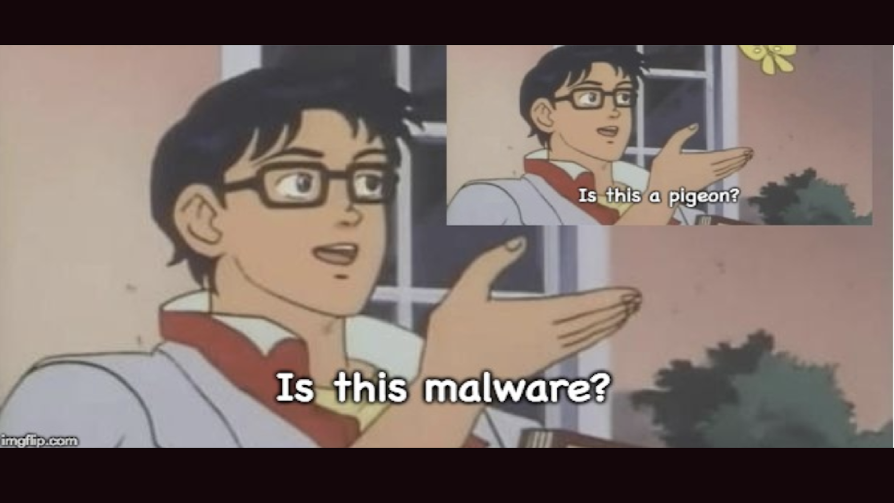

Slide 9

DATA COLLECTION
It locates and accesses the SQLite database files where browsers store login credentials, typically under User Data/Default/Login Data.
CREDENTIAL HARVESTING
It searches for authentication tokens within Discord’s LevelDB files, allowing unauthorized access to the user’s Discord account.
INFOSTEALING

Slide 10
DATA COLLECTION
It captures all keystrokes, including special keysand user input into text fields, potentially logging sensitive information like passwords.
KEYLOGGING
The malware uses the Graphics object in Windows to capture screenshots of the infected system’s display.
SCREENSHOT CAPTURE

Slide 11
DATA COLLECTION
The malware accesses the clipboard and retrieves any copied text, which could include passwords, personal messages, or other sensitive information.
CLIPBOARD DATA COLLECTION
Gathers system information, including operating system details, and identifies active processes running on the machine.
ACTIVE PROCESSES

Slide 12


EXFILTRATION OF COLLECTED DATA
TRANSMISSION METHODS
EMAIL EXFILTRATION
ALTERNATE METHODS
SMTP
FTP
Telegram
Hardcoded SMTP credentials
via FTP to a remote server
Telegram by utilizing bot tokens

Slide 13
ANTI-ANALYSIS TECHNIQUES
Verifies internet connectivity; halts if disconnected.
Potential anti-VM/sandbox detection.
ENVIRONMENT CHECKS
Extensive code obfuscation, irrelevant functions as red herrings.
Encrypted strings obscure key data.
OBFUSCATION & JUNK CODE

Slide 14
ANTI-ANALYSIS TECHNIQUES
DYNAMIC CODE LOADING
Code loaded and reassembled at runtime via Assembly.Load().
Deletes itself post-execution to avoid detection.
Kills security processes to disable monitoring.
SELF-DELETION & PERSISTENCE

Slide 15
Demo : Sandbox Analysis
https://app.any.run/tasks/b4ec4ccd-7c40-4628-8214-cb04d3c28734

Slide 16
BEST PRACTICES
REGULAR SOFTWARE UPDATES:
NETWORK SEGMENTATION
EMAIL SECURITY
RESTRICT PRIVILEGES
Strong spam filters.
Train users on phishing awareness.
Block suspicious attachments.
Limit user permissions.
Ensure users operate with the least privilege necessary.
Keep OS and applications updated to patch vulnerabilities exploited by malware.
Segregate sensitive networks and use monitoring tools.

Slide 17
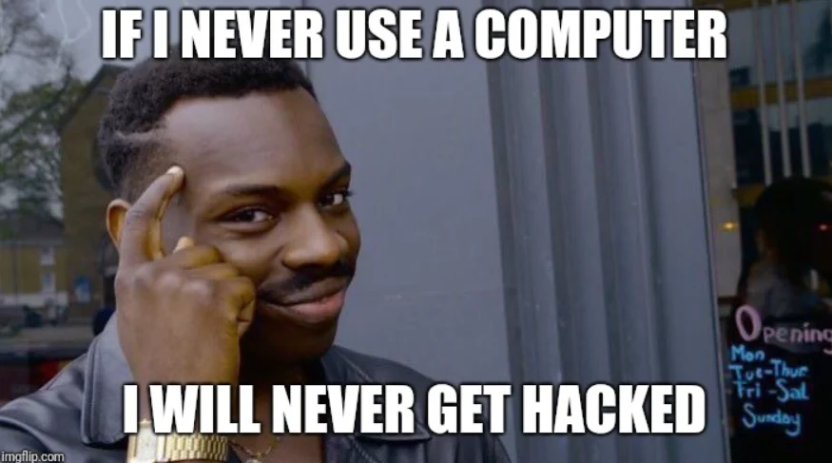

Slide 18
CONCLUSION
Snake Keylogger is a sophisticated malware that uses anti-analysis techniques like environment checks, obfuscation, and dynamic code loading to avoid detection.
It collects sensitive data, including browser credentials, application tokens, and keystrokes, making it highly dangerous for compromised systems.

Slide 19
THANK YOU
Presentation by
Ananya Avvaru & Subhiksha Rao
October | 2024

